Slide 1
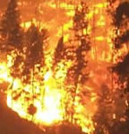
Forest Fires by Joseph Chin

Slide 2
Source
Source: https://archive.ics.uci.edu/ml/datasets/Forest+Fires
[Cortez and Morais, 2007] P. Cortez and A. Morais. A Data Mining Approach to Predict Forest Fires using Meteorological Data. In J. Neves, M. F. Santos and J. Machado Eds., New Trends in Artificial Intelligence, Proceedings of the 13th EPIA 2007 - Portuguese Conference on Artificial Intelligence, December, Guimarães, Portugal, pp. 512-523, 2007. APPIA, ISBN-13 978-989-95618-0-9.
In [Cortez and Morais, 2007], the output 'area' was first transformed with a ln(x+1) function.
Then, several Data Mining methods were applied. After fitting the models, the outputs were
post-processed with the inverse of the ln(x+1) transform. Four different input setups were
used. The experiments were conducted using a 10-fold (cross-validation) x 30 runs. Two
regression metrics were measured: MAD and RMSE. A Gaussian support vector machine (SVM) fed
with only 4 direct weather conditions (temp, RH, wind and rain) obtained the best MAD value:
12.71 +- 0.01 (mean and confidence interval within 95% using a t-student distribution). The
best RMSE was attained by the naive mean predictor. An analysis to the regression error curve
(REC) shows that the SVM model predicts more examples within a lower admitted error. In effect,
the SVM model predicts better small fires, which are the majority.

Slide 3
Index
X - x-axis spatial coordinate within the Montesinho park map: 1 to 9
Y - y-axis spatial coordinate within the Montesinho park map: 2 to 9
month - month of the year: 'jan' to 'dec'
day - day of the week: 'mon' to 'sun'
FFMC - FFMC (Fine Fuel Moisture Code) index from the FWI system: 18.7 to 96.20
DMC - DMC (Duff Moisture Code) index from the
FWI system: 1.1 to 291.3
DC - DC (Drought Code) index from the FWI system: 7.9 to 860.6
ISI - (Initial Spead Index) ISI index from the FWI system: 0.0 to 56.10
temp - temperature in Celsius degrees: 2.2 to 33.30
RH - relative humidity in %: 15.0 to 100
wind - wind speed in km/h: 0.40 to 9.40
rain - outside rain in mm/m2 : 0.0 to 6.4
area - the burned area of the forest (in ha): 0.00 to 1090.84 (this output variable is very skewed towards 0.0, thus it may make sense to model with the logarithm transform).

Slide 4
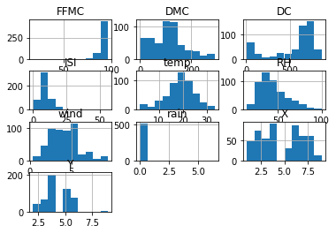
Histogram

Slide 5
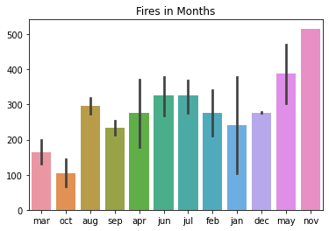
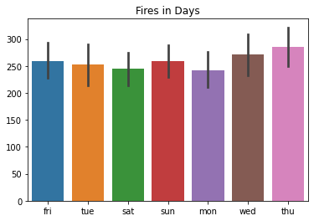
Barplot

Slide 6
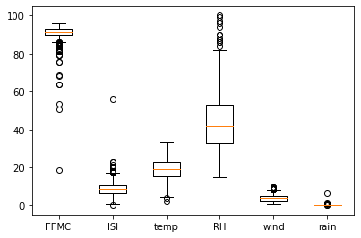
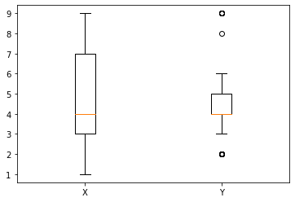
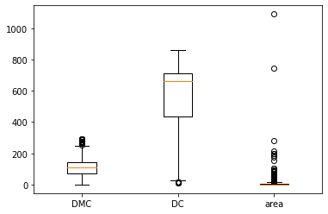
Boxplots

Slide 7
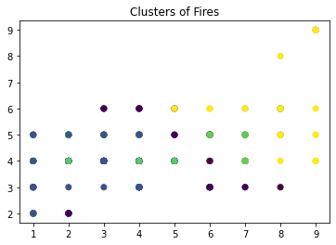
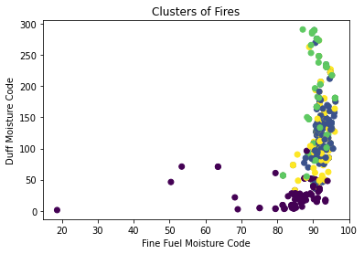
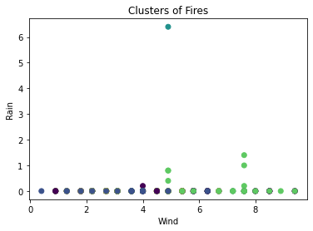
Clustering

Slide 8
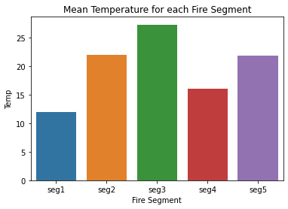
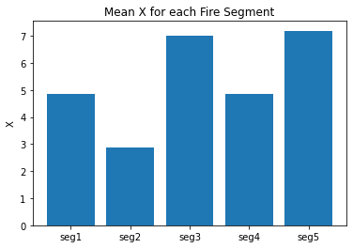
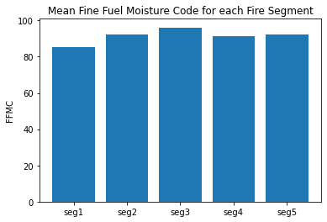
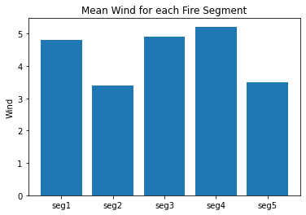
Segments

Slide 9
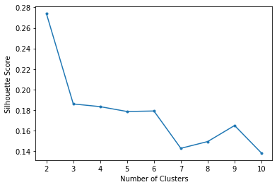
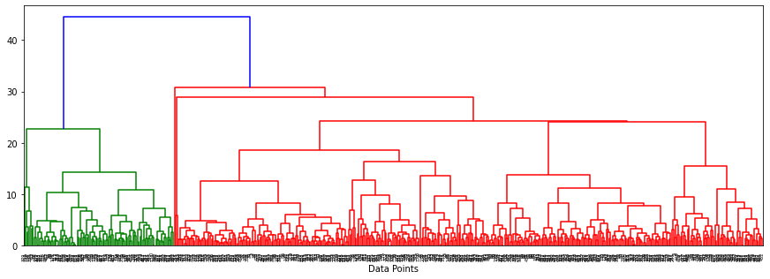
Silhouette Score & Dendrogram

